Slide 1
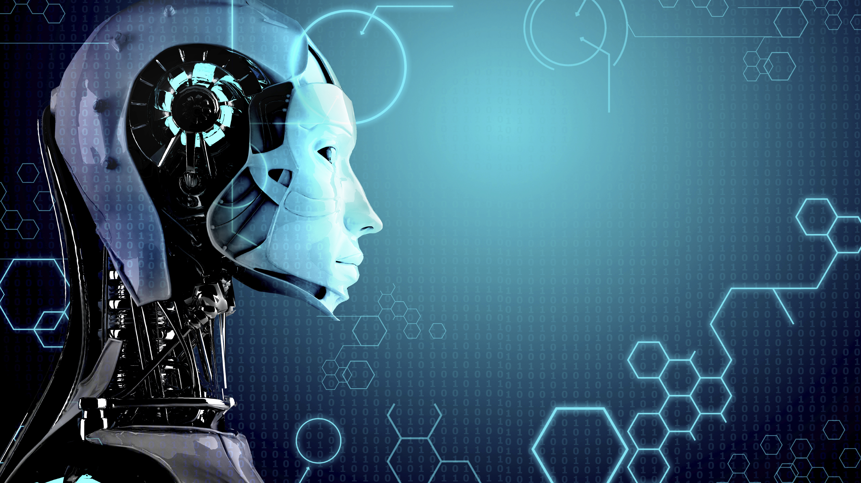
Machine learning
→ Manjunath D
ENG19CS0170

Slide 2
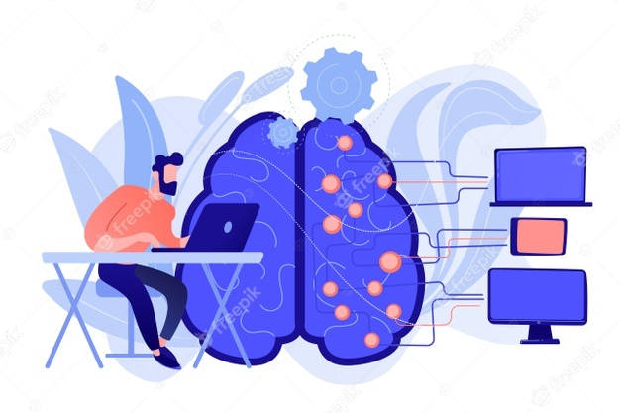
What Is Machine Learning?
ML deals with systems that can learn from data
Machine learning is a sub-field of artificial intelligence (AI) that provides systems the ability to automatically learn and improve from experience without being explicitly programmed.

Slide 3
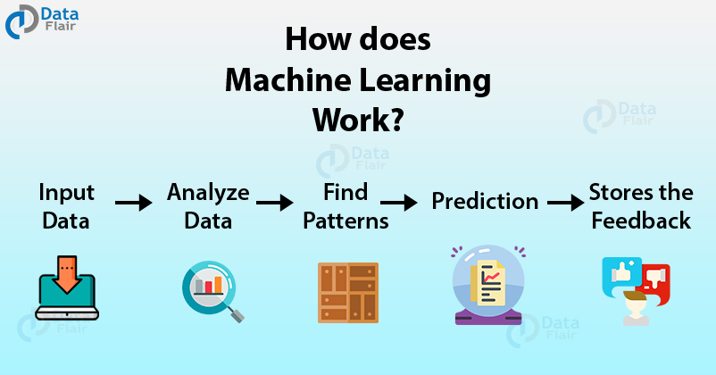

Slide 4
Types of Machine Learning
Supervised
Regression
Classification
Unsupervised
Clustering
Association
Reinforcement Learning

Slide 5
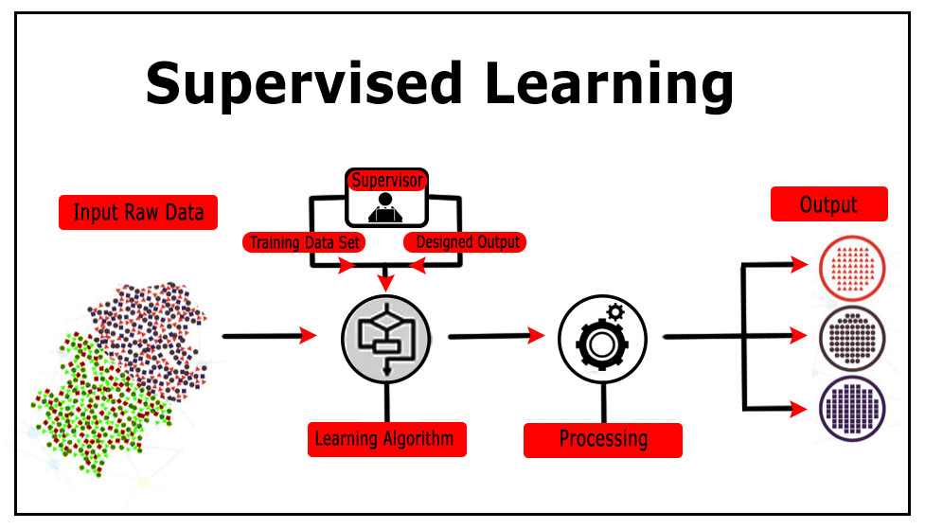
Supervised Learning
Supervised learning, as the name indicates, has the presence of a supervisor as a teacher.
Basically supervised learning is train model on a labelled dataset

Slide 6
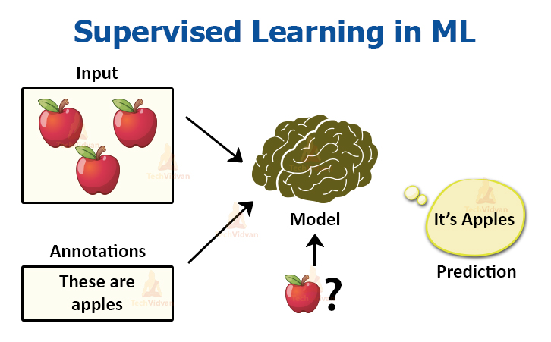

Slide 7
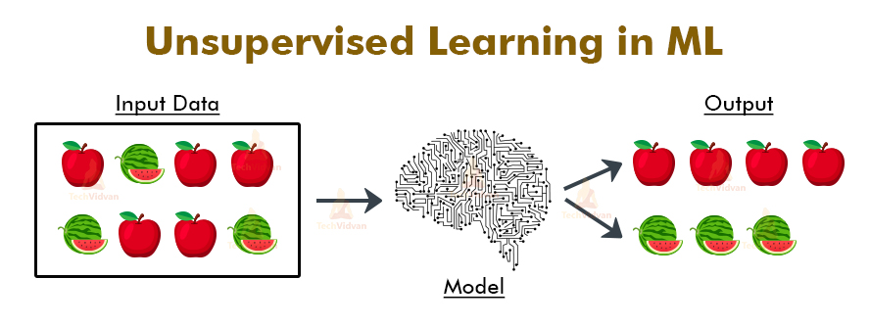
unsupervised learning
Unsupervised learning uses machine learning algorithms to analyze and cluster unlabeled data sets

Slide 8
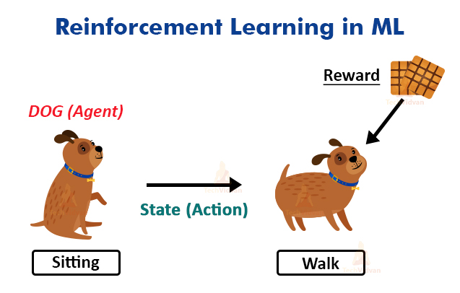
Reinforcement Learning
Reinforcement Learning is enforcing models to learn how to make decisions

Slide 9
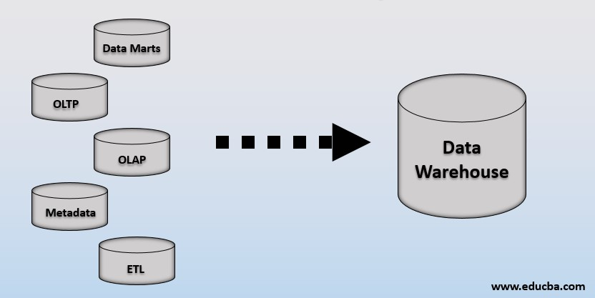
What is Data Warehouse ?
A Data Warehousing (DW) is process for collecting and managing data from varied sources to provide meaningful business insights.
Data warehouses store structured data, cleaned up and organized for specific business purposes, and serve it to reporting or BI tools used by analysts and business users.

Slide 10

What is Data Mining ?
Data Mining is a process used by companies to turn raw data into useful information.
Data Mining depends on effective data collection, warehousing, and computer processing.

Slide 11
Supervised Machine Learning Algorithms
Linear Regression
Logistic Regression
Decision Tree
Random Forest
KNN
SVM

Slide 12

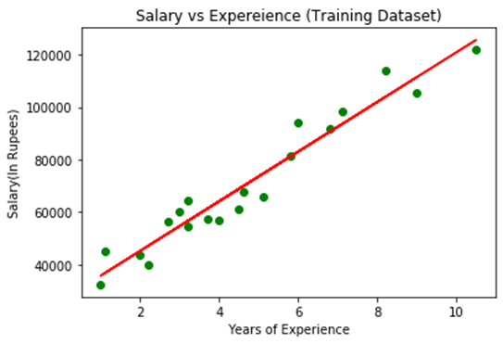
Linear Regression
Linear Regression is the supervised Machine Learning model in which the model finds the linear relationship between the dependent and independent variable.

Slide 13
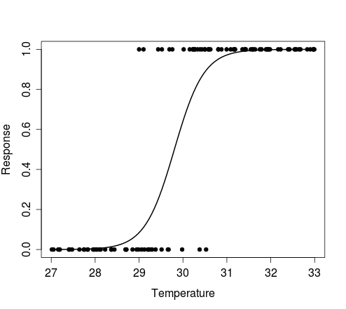
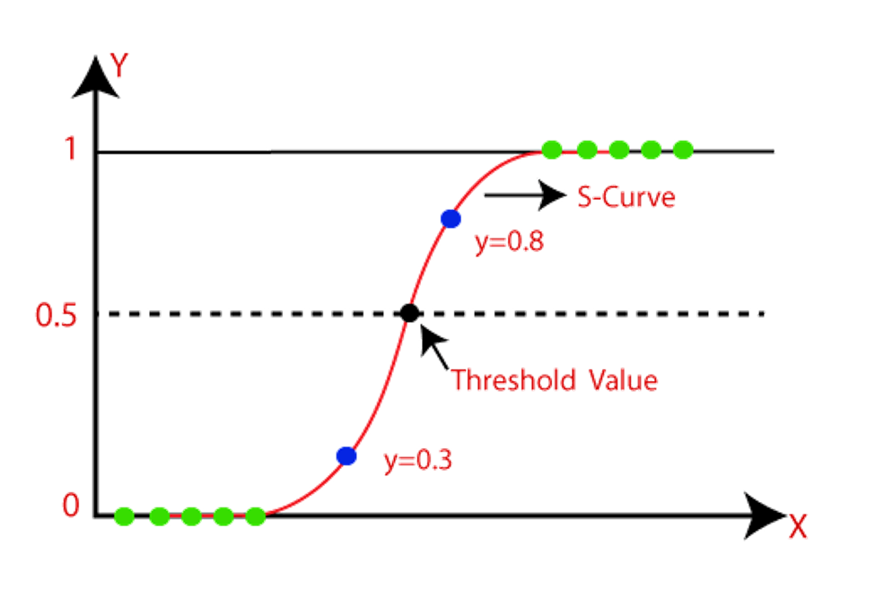
Logistic regression
Logistic regression is a statistical model that uses Logistic function to model the conditional probability

Slide 14
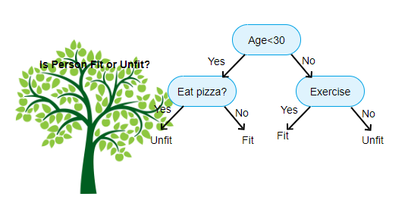
decision tree
A decision tree is a graphical representation of all the possible solutions to a decision based on certain conditions.

Slide 15
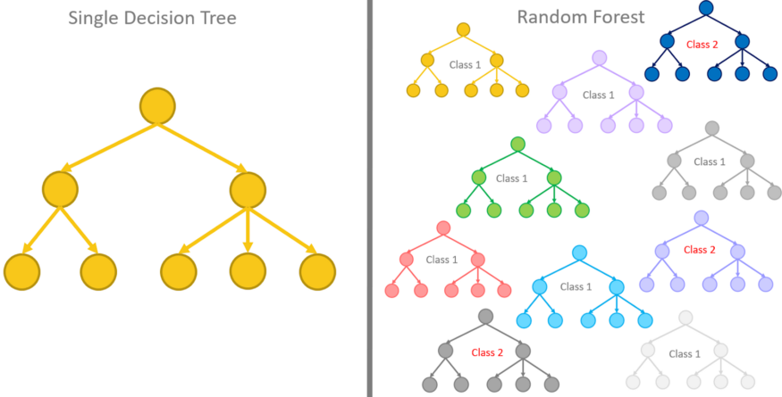
Random forest
Random Forest builds multiple decision trees and merges them together to get a more accurate and stable prediction

Slide 16
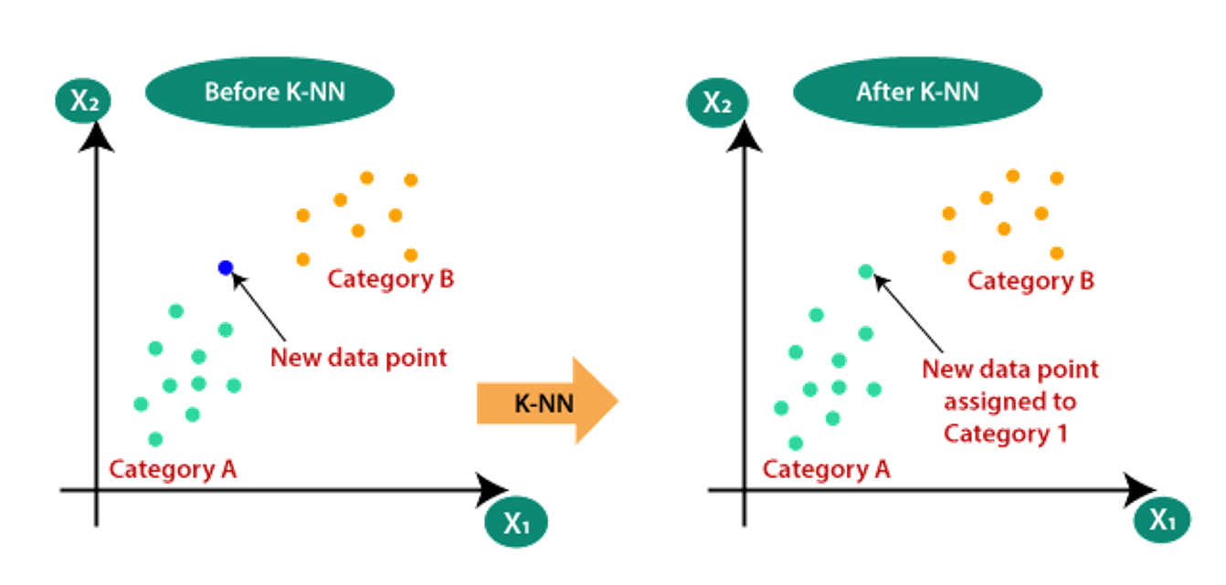
K-Nearest Neighbors
KNN is a supervised learning algorithm used for both regression and classification

Slide 17
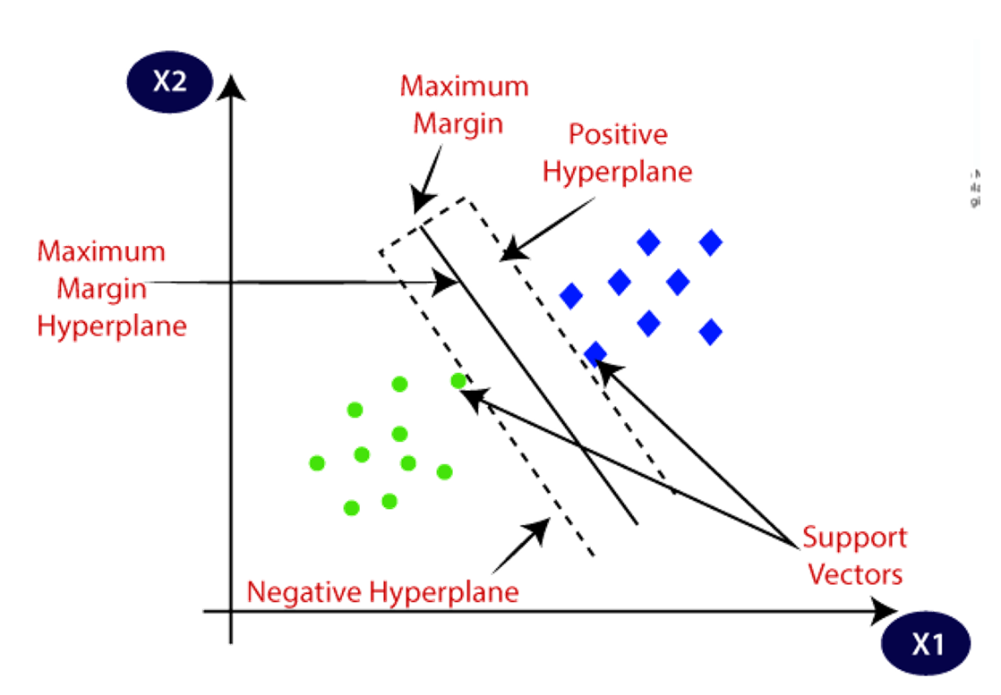
Support Vector Machine
Support Vector Machine (the “road machine”) is responsible for finding the decision boundary to separate different classes and maximize the margin.
Margins are the (perpendicular) distances between the line and those dots closest to the line.

Slide 18
Application of ML in Health care
Pattern Imaging Analytics
Personalized Treatment & Behavioral Modification
Predicting Epidemic Outbreaks
Clinical Trial Research
Identifying Diseases and Diagnosis
Robotic Surgery

Slide 19
Application of ML in Telecom
Customer Service and Satisfaction
Predictive Maintenance and Improve Network Optimization
Robotic Process Automation (RPA)
Fraud Detection

Slide 20
Thank You!
Github link for programs – click here

